Slide 1
Relation extraction using semantic web technologies
Ekal Golas
Navaneeth Venugopala rao
Prashanth govindaraj
Tejaswini sirlapu

Slide 2
Contents
Introduction
Target Audience
Description of Data Sources
Data Integration
Data Product Results
Custom Project Justification

Slide 3
Introduction
This project is about relation extraction on people and organizations from unstructured web pages.
It aims to fetch unstructured data from the web and process content to find entities and relationships between them. Supported relationships: People, Organizations, Locations, Dates, Financial values
These extracted entities and relationships, are modelled by a semantic ontology, and organized in a structured format.
A website has been developed, where the user can search for different entities and obtain relationships and linked information about that entity.

Slide 4
Target Audience
Financial/Marketing analysts – As a relation between entities and financial values is developed, the structured data can be used to answer queries based on financial values related to a person or an organization
Statistical users – This structured data can be queried to obtain statistics about a region, person, organization or location
Random web user – A random web user can browse this website to find structured information – relationships and linked information about a person or an organization – in one place, though the data could be from various sources.

Slide 5
Description of data sources
The data is described as:-
A collection of web pages, indexed and stored in SolR
The ideal webpages will be about people, organizations, locations and related financial information. For example, news articles, wiki pages, etc.
The sample data used for this presentation is small, however the techniques used are easily scalable
Data is available publicly on the internet

Slide 6
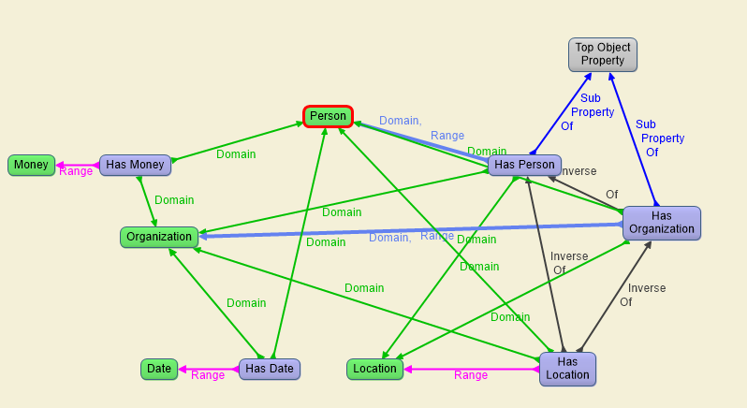
Custom Ontology Description

Slide 7
Data Integration
Data is integrated in the following steps:-
Firstly, a set of documents is stored in Apache SolR
Then this data is read from SolR and fed into Stanford CoreNLP API to perform Named Entity Tagging on the data, and relationships between the tagged entities are established
This relationship data is then fed into Apache Jena, which reads the custom ontology in Figure 1 above (in RDF/XML format), and transforms the data into RDF/XML and N-Triples
The resulting data store can be queried by the user using a website
This integration from end-to-end provides the experience of transformation of unstructured data scattered over the web into a structured, linked format that the user can make sense of and derive meaningful information from.

Slide 8
Data Product Results
Following was the expected results of this project:-
Getting an insight as to how people, organization and locations are related to each other.
Possible financial information related to these results
Visualization of this data as a graph
These results are interesting because they can help financial/marketing analysts make better sales/business decisions based on extracted relationships and structures data visualizations. Even casual users might benefit by gathering general knowledge from this data.

Slide 9
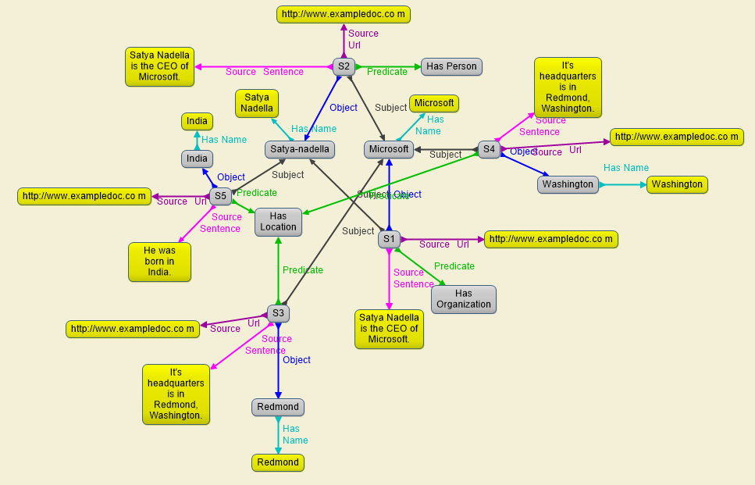
Sample visualization graph

Slide 10
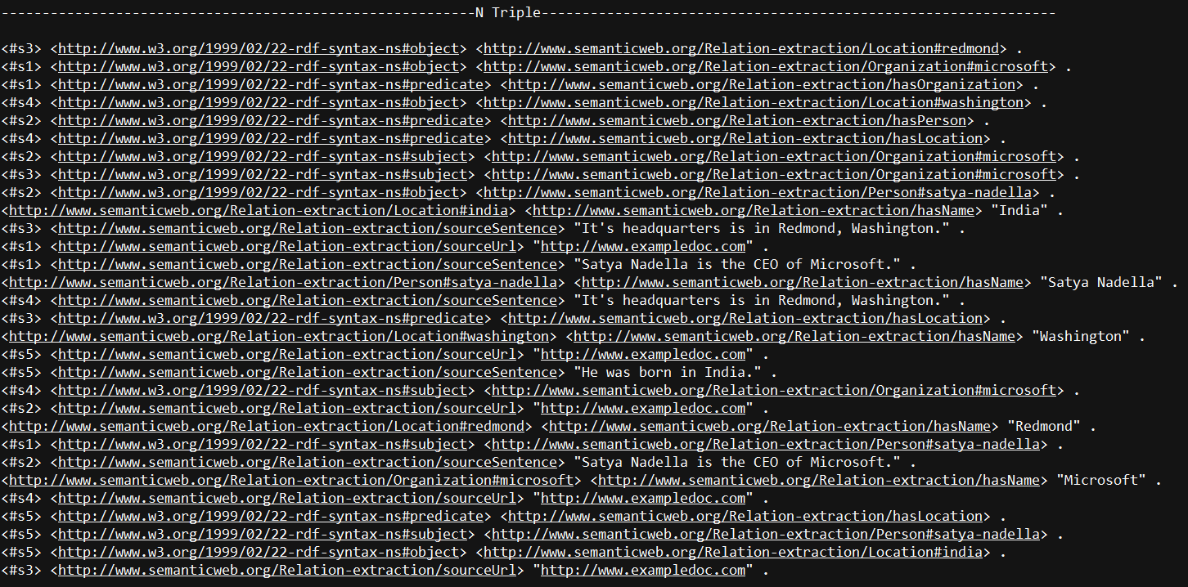
Graph stored as N-triple format

Slide 11
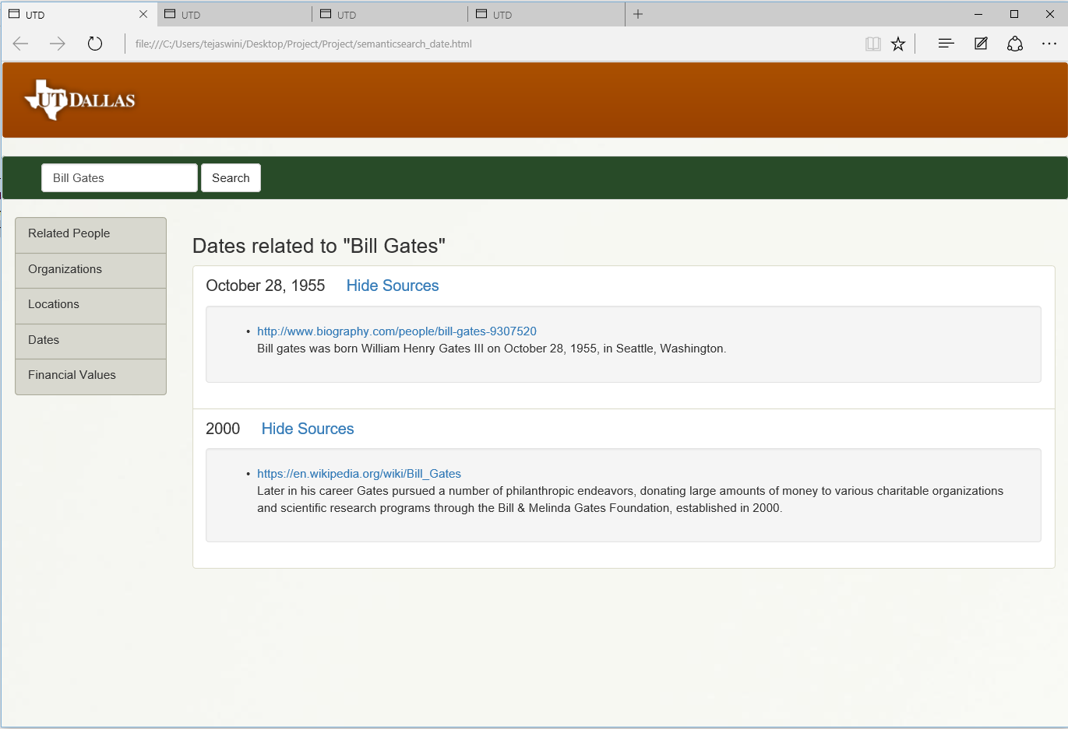
Person to Date Relation

Slide 12
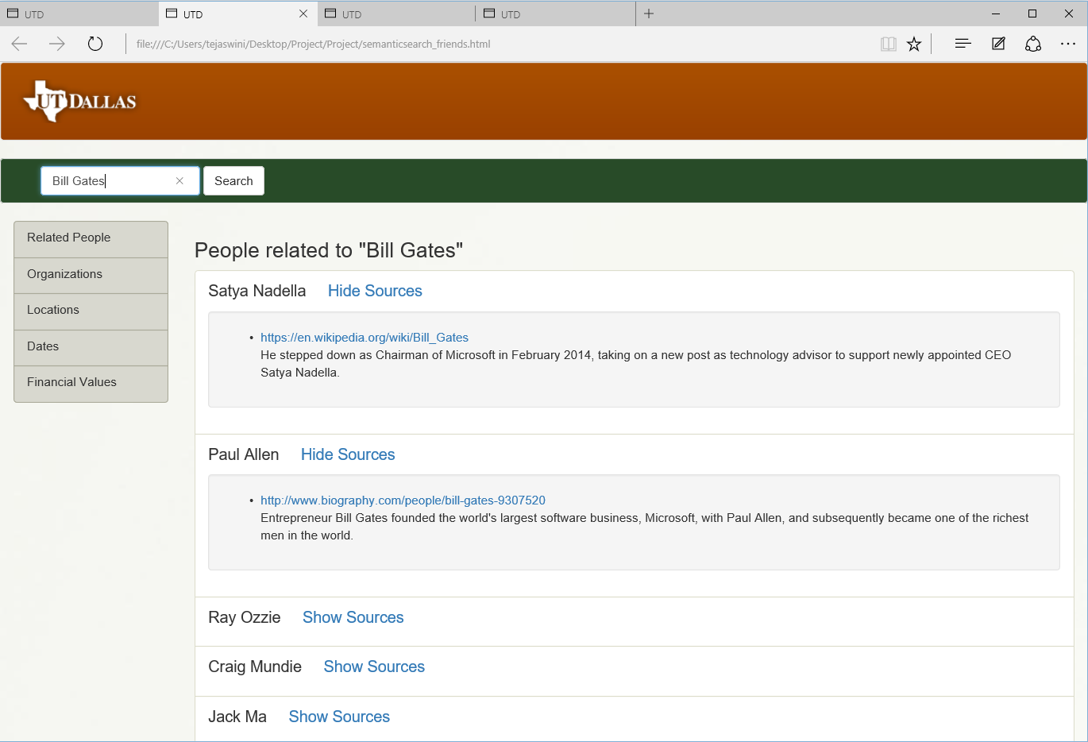
Person to People Relation

Slide 13
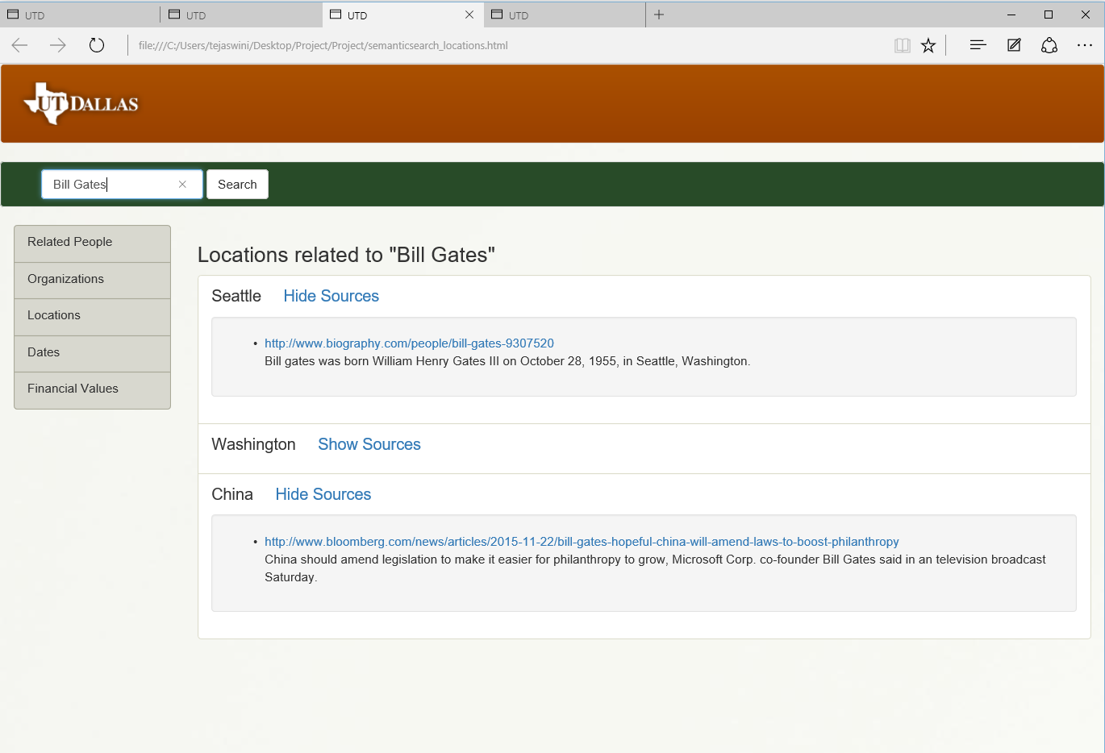
Person to Location Relation

Slide 14
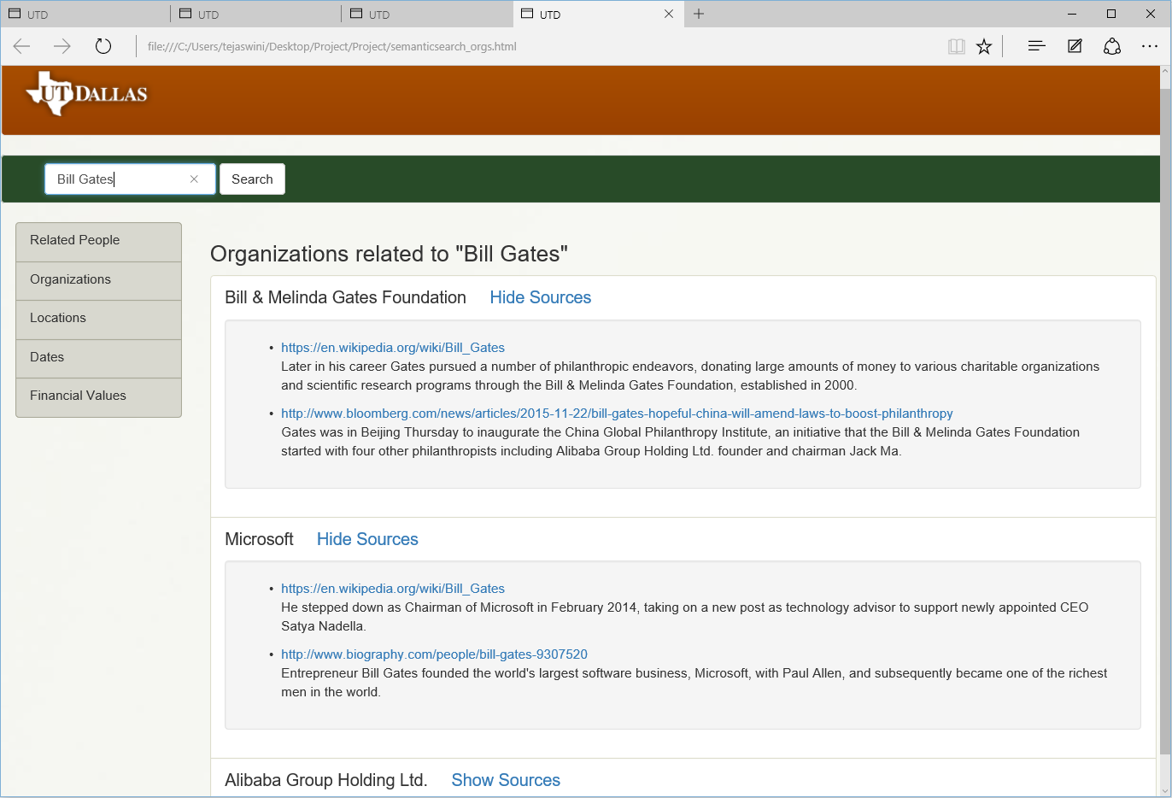
Person to Organization Relation

Slide 15
Custom project Justification
This project differs from an LOGD project in the following ways:-
Different source of data – The LOGD website was not used as the data source
Wider range of tools used – Including the use of Jena, Gruff, Protégé, other technologies like SolR, HTML, CSS, JavaScript, Java, Stanford CoreNLP API were also used for end-to-end integration
Custom Ontology – A custom ontology was defined to model and structure the data and the results displayed were structured using this model.

Slide 16
Summary
As discussed, this project successfully extracts relations in unstructured data using Natural Language Processing techniques and represents them as structured, semantic data.
As shown in the figures, these relations in the data are successfully displayed on a website for the user to derive meaningful information from.
The report also described the relevance of these results, the target audience for whom these result may prove to be relevant and the justification for this custom project.
Although a small sample of data was showcased, the project can be scaled to much larger size of data, and can present to the user a much wider expanse of entities to search and derive structured information about.

